Slide 1
Network Optimization
CONTENTS:
Introduction to Network Flows (Sections 1.1 and 1.2)
Network Notation (Section 2.2)
Complexity Analysis (Section 3.2)
READING ASSIGNMENTS:
Chap 1, 2, 3
Appendix A, B
Notes:
Obtain a network, and use the same network to illustrate the shortest path problem for communication networks, the max flow problem, the minimum cost flow problem, and the multicommodity flow problem. This will be a very efficient way of introducing the four problems. (Perhaps under 10 minutes of class time.)

Slide 2
Quick Overview
Next: The Koenigsberg Bridge Problem
  Introduces Networks and Network Algorithms
Some subject management issues
Network Flows and Applications
Computational Complexity
Overall goal of today’s lecture:
  provide background
  provide motivation
  handle some class logistics

Slide 3
The Bridges of Koenigsberg: Euler 1736
“Graph Theory” began in 1736
Leonard Eüler
  Visited Koenigsberg
  People wondered whether it is possible to take a walk, end up where you started from, and cross each bridge in Koenigsberg exactly once
  Generally it was believed to be impossible

Slide 4
The Bridges of Koenigsberg: Euler 1736
A
1
2
3
B
4
C
5
6
7
D
Is it possible to start in A, cross over each bridge exactly once, and end up back in A?

Slide 5
The Bridges of Koenigsberg: Euler 1736
A
1
2
3
B
4
C
5
6
7
D
Conceptualization: Land masses are “nodes”.

Slide 6
The Bridges of Koenigsberg: Euler 1736
A
1
2
3
B
4
C
5
6
7
D
Conceptualization: Bridges are “arcs.”

Slide 7
The Bridges of Koenigsberg: Euler 1736
A
1
2
3
B
4
C
5
6
7
D
Is there a “walk” starting at A and ending at A and passing through each arc exactly once?

Slide 8
Network Notation
2
4
2
4
1
5
7
1
5
7
3
6
3
6
An Undirected Graph or
Undirected Network
A Directed Graph or
Directed Network
Network (or graph) G = (N, A)
N : Node Set = {1, 2, 3, 4, 5, 6, 7}
A : Arc Set = {(1, 2), (1, 3), (2, 3), (2, 4), (3, 6), (4, 5), (4, 7), (5, 2), (5, 3), (5, 7), (6, 7)}

Slide 9

Tails and Head Nodes
2
4
1
5
7
3
6
Tail Node : Node i is the tail node of arc (i, j)
Head Node : Node j is the head node of arc (i, j)
Endpoints : Nodes i and j are endpoints of arc (i, j)
(outgoing) Arc Adjacency List A(i) = {(i, j) : (i, j) ∈ A}
Observe that

Slide 10
Walks
2
4
1
5
7
3
6
Subgraph: G' = (N', A') is a subgraph of G = (N, A)
if N' ⊆ N and A' ⊆ A.
Spanning Subgraph: G' = (N', A') is a spanning subgraph of G = (N, A) if N' = N and A' ⊆ A.
Walk: A walk in a directed graph G is a subgraph of G consisting of a sequence of nodes and arcs.
(the arcs may have different orientations)
Directed Walk: A directed walk in which all arcs have the same orientation.

Slide 11
Paths and Cycles
2
4
2
4
1
5
7
1
5
7
3
6
3
6
(simple) Path : A walk without any repetition of nodes.
Directed Path: A directed walk without any repetition of nodes. (thus, same orientation)
(simple) Cycle: A walk without any repetition of nodes except the same starting and ending nodes.
Directed Cycle: A directed version of a cycle. (thus, same orientation)
Acyclic Network: A network that has no directed cycle.

Slide 12
Network Connectivity
2
4
2
4
1
5
7
1
5
7
3
6
3
6
Connected Graph: If every pair of nodes is connected by a path.
Strongly Connected Graph: If every pair of nodes is connected by a directed path.
Disconnected Graph: If some pair of nodes is not connected by a path.
Components: maximally connected subgraphs of a disconnected graph.
Notes:
Strongly connected: every node to every other node!! Check definitions in the book.

Slide 13

Cuts
S
2
4
1
5
7
3
6
Cut: A cut is a set of arcs whose deletion disconnects the network into two components S and and no subset of it has this property. A cut is represented by [S, ].

Slide 14
Trees
Tree: A tree is a connected graph that contains no cycle.
2
4
2
4
1
7
1
3
6
3
6
Properties:
A tree on n nodes contains exactly n-1 arcs.
A tree has at least two leaf nodes.
Every two nodes of a tree are connected by a unique path.

Slide 15
Spanning Trees
Spanning Tree: A subgraph of a graph which is a tree and contains every node of the graph.
2
4
2
4
1
5
7
1
5
7
3
6
3
6
Forest: A graph that contains no cycle is a forest.
(thus a forest may contains several components which are trees)
A forest on n nodes and k components has n-k arcs.

Slide 16
Directed Out-Trees and In-Trees
Directed-out-tree: A tree in which the unique path in the tree from node s to every other node is a directed path.
Directed-in-tree: A tree in which the unique path in the tree from any node to node s is a directed path.
8
8
3
7
3
7
6
6
1
2
1
2
4
5
4
5

Slide 17
Bipartite Graph
Bipartite Graph K: A graph G = (N, A) is a bipartite graph if node set N can be partitioned into the sets N¹ and N² such that each arc (i, j) has either
  (i) i ∈ N¹ and j ∈ N²; or (ii) i ∈ N² and j ∈ N¹.
1
1
5
4
7
3
2
5
4
8
3
6
2
A graph G is a bipartite graph if and only if
every cycle in it has even number of arcs.

Slide 18
Back to the Bridges of Koenigsberg
b
1
2
a
c
e
4
d
3
5
Walks are paths that can repeat nodes and arcs
Example of a directed walk: 1-2-3-5-4-2-3-5
A walk is closed if its first and last nodes are the same.
A closed walk (circuit) is a cycle except that it can repeat nodes and arcs.

Slide 19
The Bridges of Koenigsberg: Euler 1736
A
1
2
3
B
4
C
5
6
7
D
Is there a “closed walk” passing through each arc exactly once?
Such a walk is called an eulerian circuit.

Slide 20
Adding two bridges creates such a walk
A
Add 2 bridges
8: (A,C)
9: (B,D)
3
8
1
2
B
4
C
5
6
9
7
D
Here is the walk.
A, 1, B, 5, D, 6, B, 4, C, 8, A, 3, C, 7, D, 9, B, 2, A
Note: the number of arcs incident to B is twice the number of times that B appears on the walk.

Slide 21
On Eulerian Circuits
A
3
The degree of a node in an undirected graph is the number of incident arcs
8
1
2
B
4
C
5
6
9
7
D
4
Theorem. An undirected graph has an eulerian circuit if and only if
(1) every node has even degree and
(2) the graph is connected (that is, there is a path
from each node to each other node).

Slide 22
More on Euler’s Theorem
Necessity of two conditions: ➔
Any eulerian circuit “visits” each node an even number of times
Any eulerian circuit shows the network is connected
Sufficiency of the condition: ⬅
Assume the result is true for all graphs with fewer than |A| arcs.
Start at some node, and take a walk until a cycle C is found.
1
4
4
7
7
3
5
3
5

Slide 23
More on Euler’s Theorem
Sufficiency of the condition: ⬅
  Start at some node, and take a walk until a cycle C is found.
  Consider G’ = (N, A\C)
    the degree of each node is even
    each component is connected
So, G’ is the union of Eulerian cycles
Connect G’ into a single eulerian circuit by adding C.
5
4
7
3

Slide 24
Comments on Euler’s theorem
It reflects how proofs are done in class, often in outline form, with key ideas illustrated.
However, this proof does not directly lead to an efficient algorithm.
Usually we focus on efficient algorithms.

Slide 25
Hamiltonian Cycles
A hamiltonian cycle is a cycle that passes through each node of the graph exactly once.
This is often called a traveling salesman tour.

Slide 26
Hamilton’s Around the World Game
In 1857, the Irish mathematician, Sir William Rowan Hamilton invented a puzzle that he hoped would be very popular.
The objective was to make a hamiltonian cycle.
The game was not a commercial success, especially the 3D version. But the mathematics of hamiltonian cycles is very popular today.

Slide 27
Hamilton’s Around the World Game
This problem can be generalized to be the
traveling salesman problem.

Slide 28
Traveling Salesman Problem
Given
  a finite number of "cities"
  the cost of travel between each pair of them
Find
  the cheapest way of visiting all the cities and returning to your starting point.
Largest cases solved to date
  15,112 cities in Germany
  110 processors (Compaq EV6 Alpha at 500 MHz )
  total computer time 22.6 years
TSP is NP hard
  Heuristics (Local Search, GA, SA, Tabu search,
  Ant Colony, …etc)

Slide 29
Where Network Flows Arise
Transportation
  Transportation of goods over transportation networks
  Scheduling of fleets of airplanes: time/space networks
Manufacturing
  Scheduling of goods for manufacturing
  Flow of manufactured items within inventory systems
Communications
  Design and expansion of communication systems
  Flow of information across networks
Personnel Assignment
  Assignment of crews to airline schedules
  Assignment of drivers to vehicles
Notes:
See if I can tie this back to the student’s comments about thesis work.

Slide 30
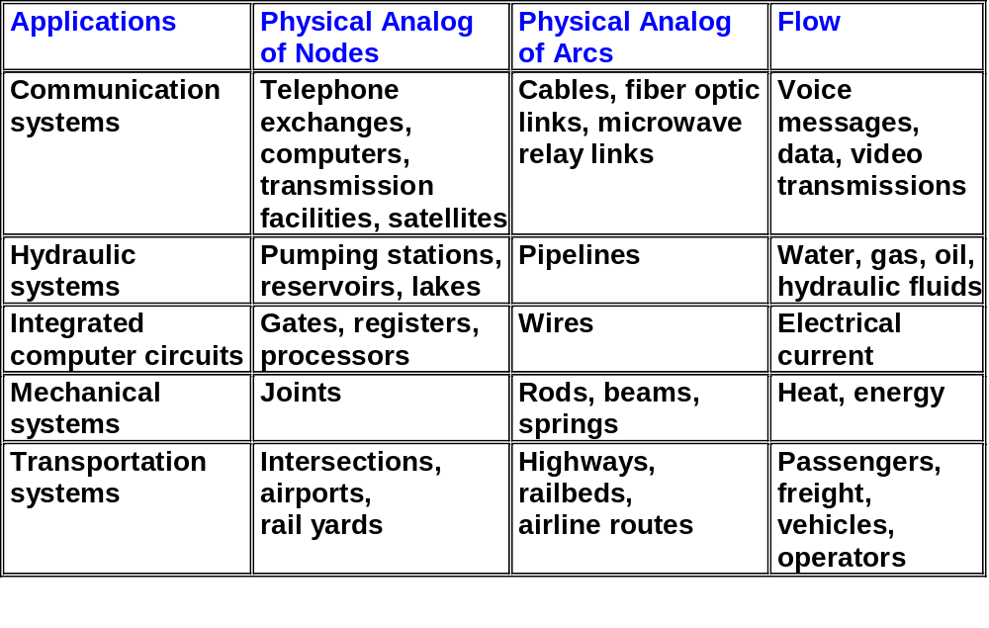
Some Common Physical Networks

Slide 31
The shortest path problem
Consider a network G = (N, A) in which there is an origin node s and a destination node t.
standard notation: n = |N|, m = |A|
Determine a shortest path :
from s to t (1-ALL)
from each node to each other node (ALL-ALL)
from some nodes to some other nodes (SOME-SOME)
2
4
4
2
2
Applications:
Finding a path
of minimum length
taking minimum time
of maximum reliability
1
1
2
3
1
6
s
4
2
t
3
3
5
A Network with Arc Lengths

Slide 32
The Maximum Flow Problem
Directed Graph G = (N, A).
  Source s, Sink t, Capacities u_{ij} on arc (i,j)
  Maximize the flow out of s, subject to
Flow out of i = Flow into i, for i ≠ s or t.
u_{ij}, x_{ij}
Applications:
Determining maximum steady-state flow of:
petroleum products in a pipeline network
cars in a road network
messages in a telecom network
electricity in an electrical network
1
8,
8
10
,
9
s
1,
1
t
6,
6
10,
7
2
A Network with Arc Capacities

Slide 33
Representing the Max Flow as an LP
1
8,
8
10
,
9
Flow out of i - Flow into i = 0 for i ≠ s or t.
s
1,
1
t
6,
6
10,
7
2
max v
max v
s.t x_{s1} + x_{s2} = v
s.t. Σ_{j} x_{sj} = v
-x_{s1} + x₁₂ + x_{1t} = 0
Σ_{j} x_{ij} – Σ_{j} x_{ji} = 0
for each i ≠ s or t
-x_{s2} - x₁₂ + x_{2t} = 0
-x_{1t} - x_{2t} = -v
s.t. - Σ_{i} x_{it} = -v
0 ≤ x_{ij} ≤ u_{ij} for all (i,j)
0 ≤ x_{ij} ≤ u_{ij} for all (i,j)

Slide 34
Minimum Cost Network Flow (1)
Determine a least cost shipment of a commodity through a network in order to satisfy demands at certain nodes from available supplies at other nodes. Arcs have capacities and cost associated with them.
-15
2
2,5
4
c_{ij},u_{ij}
2,7
5,4
3,5
1,9
10
1
4,4
5
4,5
7
10
3,9
6,5
6,6
Applications:
Distribution of products
Flow of items in a production line
Routing of cars through street networks
Routing of telephone calls
3
6
5,8
-5

Slide 35
Min-Cost Network Flows (2)
5
Flow out of i - Flow into i = b(i)
2
$4 ,10
Each arc has a linear cost and a capacity
1
4
3
min Σ_{i,j} c_{ij}x_{ij}
s.t Σ_{j} x_{ij} – Σ_{j} x_{ji} = b(i) for each i
l_{ij} ≤ x_{ij} ≤ u_{ij} for all (i,j)
Covered in detail in Chapter 9~11 of AMO

Slide 36
Minimum Spanning Tree Problem
Find a spanning tree of an undirected network of minimum cost (or, length).
10
4
2
35
20
15
1
25
40
3
30
5
Applications:
Constructing highways or railroads spanning several cities
Designing local access network
Making electric wire connections on a control panel
Laying pipelines connecting offshore drilling sites, refineries, and consumer markets

Slide 37
Complexity Analysis
How to judge the goodness of an algorithm?
How economically it uses the computing resources:
  Time efficiency
  Space efficiency
Time is more crucial in practice.
How to judge the time requirement of an algorithm?

Slide 38
Two Type of Analysis
Empirical Analysis
  Implementation dependent
  Often inconclusive
  Too expensive and time-consuming
Worst-Case Analysis
  Obtain upper bounds on the number of steps (operations)
  Often easy to perform
  Mostly conclusive
  Bad examples determine the performance
  Most popular

Slide 39
Measuring Computational Complexity
Consider the following algorithm for adding two m × n matrices A and B with coefficients a(*,*) and b(*,*).
begin
  for i = 1 to m do
  for j = 1 to n do c(i,j) := a(i,j) + b(i,j)
end
The precise number of steps is implementation dependent and is very difficult to count.
MORALE:
  Ignore the constants
  Count each operation as one step
  Consider the most dominant term when problem size becomes sufficient large

Slide 40
Order Notation
Big O : An algorithm is said to run in O(f(n)) time if for some numbers c and n₀, the time taken by the algorithm is at most cf(n) for all n ≥ n₀.
Big Ω : An algorithm is said to run in Ω(f(n)) time if for some numbers c’ and n₀ and for all n ≥ n₀, the algorithm takes at least cf(n) time for some problem instances.
  Whereas Big O notation gives an upper bound on the running time of an algorithm, Big Ω notation gives a lower bound on the running time of an algorithm.
Big θ : An algorithm is said to be a θ(f(n)) algorithm if the algorithm is both O(f(n)) and Ω(f(n)).
  The bubble sort algorithm is a θ(n²) time algorithm

Slide 41
Towards Computational Complexity
We will ignore running time constants, focus on the rate of growth in solution time as the problem size increases.
(thus, an asymptotic running time analysis)
Our running times will be stated in terms of relevant problem parameters (sizes), e.g., n, m, log C, log U.
(thus, a function of n, m, log C, log U.)
We will measure everything in terms of worst case or most pessimistic analysis (performance guarantees.)
All arithmetic operations (+,-,*,/) are assumed to take one step, (or a number of steps that is bounded by a constant).

Slide 42
A Simpler Metric for Running Time
Operation Number (as a function of m,n)
Additions ≤ c₁ mn for some c₁ and m, n ≥ 1
  O(mn) steps
Assignments ≤ c₂ mn for some c₂ and m, n ≥ 1
  O(mn) steps
Comparisons ≤ c₃ mn for some c₃ and m, n ≥ 1
  O(mn) steps
TOTAL ≤ c₄ mn for some c₄ and m, n ≥ 1
  O(mn) steps

Slide 43
Simplifying Assumptions and Notation
MACHINE MODEL: Random Access Machine (RAM).
This is the computer model that everyone is used to. It allows the use of arrays, and it can select any element of an array in O(1) steps.
  Instructions are executed one after another (NO concurrent operations)
  Use common instructions (assume each one takes a constant amount of time): Arithmetic (+,-,*,/,mod,floor,ceiling,shift right/left), data movement (load,store,copy), control (if..else,case)
Integrality Assumption: All numbers are integral (unless stated otherwise.)
Similarity Assumption:
in networks where C=max{|c_{ij}|}, U=max{u_{ij}}
  C & U are polynomially bounded by n
  i.e. C=O(n^{k}), and U=O(n^{k}), for some k

Slide 44
Size of a problem
The size of a problem is the number of bits needed to represent the problem.
  In networks, usually we use n=|N|, m=|A|, log C, log U as the size of a problem
The size of the n × m matrix A is not nm.
  If each matrix element has K bits, the size is nmK
  e.g., if max 2¹⁰⁷ < a_{ij} < 2¹⁰⁸, then K = 108.
  K = O( log (a_{max})).

Slide 45
Polynomial Time Algorithms
We say that an algorithm runs in polynomial time if the number of steps taken by an algorithm on any instance I is bounded by a polynomial in the size of I.
We say that an algorithm runs in exponential time if it does NOT run in polynomial time.
Example 1: finding the determinant of a matrix can be done in O(n³) steps.
  This is polynomial time.

Slide 46
Polynomial Time Algorithms
Example 2: We can determine if n is prime by dividing n by every integer less than n.
  This algorithm is exponential time.
  The size of the instance is log n
  The running time of the algorithm is O(n).
  Side note: there is a polynomial time algorithm for determining if n is prime. (2002, a simple deterministic algorithm)
Almost all of the algorithms presented in this class will be polynomial time.
One can find an Eulerian circuit (if one exists) in O(m) steps.
There is NO known polynomial time algorithm for finding a hamiltonian cycle.
Notes:
http://www.cse.iitk.ac.in/news/primality.html

Slide 47
More examples on complexity
Polynomial Time Algorithms
  Examples: O(n²), O(nm), O(m + n log n), O(m log C).
Exponential Time Algorithms
  Examples: O(2^{n}), O(n!)
Pseudo-Polynomial Time Algorithms
  Examples: O(m+nC).

Slide 48
On polynomial vs. exponential time
We contrast two algorithm, one that takes 30,000 n³ steps, and one that takes 2^{n} steps.
Suppose that we could carry out 1 billion steps per second.
# of nodes 30,000 n³ steps 2^{n} steps
  n = 30, 0.81 seconds 1 second
  n = 40, 1.92 seconds 17 minutes
  n = 50 3.75 seconds 12 days
  n = 60 6.48 seconds 31 years

Slide 49
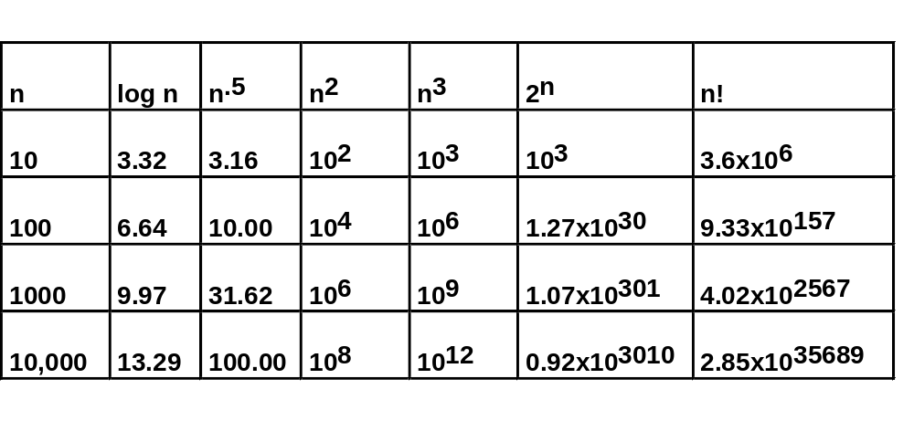
Growth Rates of Various Functions

Slide 50

Efficient algorithms? (1)
“I can’t find an efficient algorithm, I guess I’m just too dumb.”
Serious damage to your
position within the company !!!

Slide 51

Efficient algorithms? (2)
“I can’t find an efficient algorithm, because no such algorithm is possible!”
Unfortunately, proving intractability can be just
as hard as finding efficient algorithms !!!
∴ No hope !!!
P ≠ NP

Slide 52
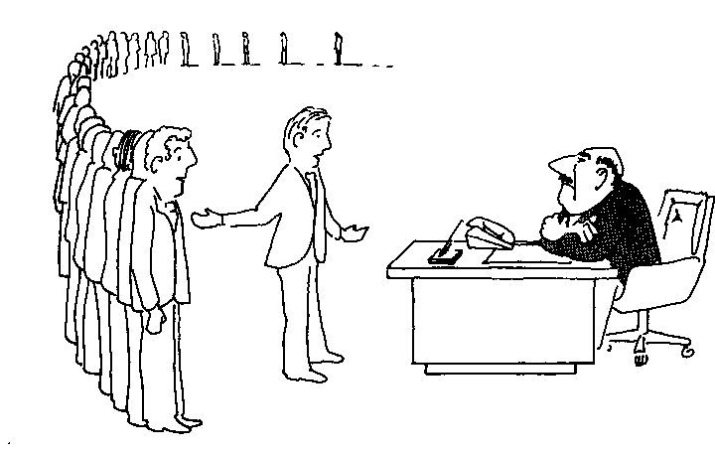
Efficient algorithms? (3)
“I can’t find an efficient algorithm, but neither can all these famous people”

Slide 53

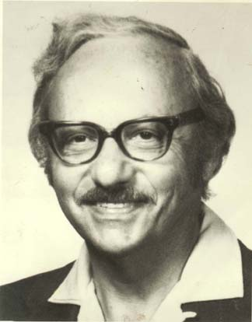
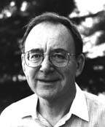
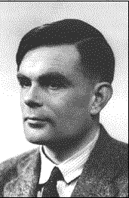

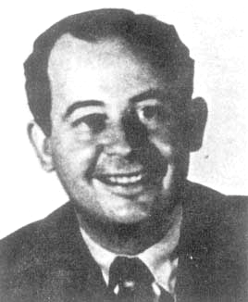
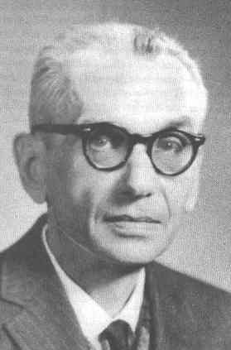


David Johnson
George Dantzig
Richard Karp
Alan Turing
Michael Garey
Ralph Gomory
John Von Neumann
Kurt Gödel
Steven Cook

Slide 54

Efficient algorithms? (4)
“Anyway, we have to solve this problem.
Can we satisfy with a good solution ? “

Slide 55
Overview of this lecture
Eulerian circuits
Network Definitions
Network Applications
Introduction to computational complexity

Slide 56
Upcoming Lectures
Lecture 2: Review of Data Structures
Lecture 3. Graph Search Algorithms.
  how to determine if a graph is connected
  and to label a graph
  and more

